Slide 1
Russian Handwritten Lexicons:
Digital Representation
Kira Kovalenko
ILS, RAS

Slide 2



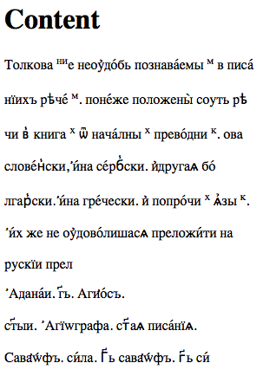
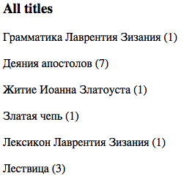

Slide 3

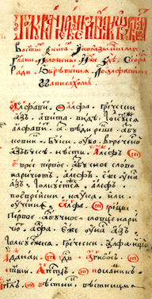
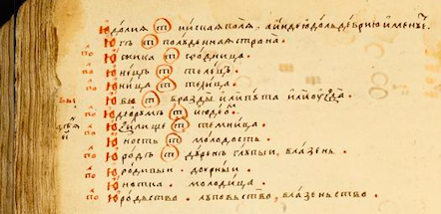
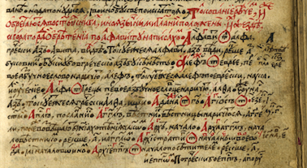
more lexicons with TEI mark up
more complicated structure of entries
more search options
linking text to the facsimile
automatic collation
open access

